Slide 1

Chapter 1
Introduction to Statistics (Part 2)
Notes:
Slide 15

Slide 2
Measurement Error
Measurement error
  The discrepancy between the actual value we’re trying to measure, and the number we use to represent that value.
Example:
  You (in reality) weigh 80 kg.
  You stand on your bathroom scales and they say 83 kg.
  The measurement error is 3 kg.
Notes:
80kg = 176.37
3kg = 6.61

Slide 3
Validity
Whether an instrument measures what it set out to measure.
Content validity
  Evidence that the content of a test corresponds to the content of the construct it was designed to cover
Ecological validity
  Evidence that the results of a study, experiment or test can be applied, and allow inferences, to real-world conditions.
Notes:
Many types of validity. Let’s just focus on these two for now

Slide 4
Reliability
Reliability
  The ability of the measure to produce the same results under the same conditions.
Test-Retest Reliability
  The ability of a measure to produce consistent results when the same entities are tested at two different points in time.

Slide 5
How to Measure? (1)
Correlational research:
  Observing what naturally goes on in the world without directly interfering with it.
Cross-sectional research:
  This term implies that data come from people at different age points with different people representing each age point.
  Commonly used in developmental studies!

Slide 6
How to Measure? (2)
Experimental research:
  One or more variable is systematically manipulated to see their effect (alone or in combination) on an outcome variable.
  Statements can be made about cause and effect.
  The experimental research strategy is the only one that can infer cause!

Slide 7
Experimental Research Methods (1)
Cause and Effect (Hume, 1748)
  Cause and effect must occur close together in time (contiguity);
  The cause must occur before an effect does;
  The effect should never occur without the presence of the cause.

Slide 8
Experimental Research Methods (2)
Confounding variables: the ‘Tertium Quid’
  A variable (that we may or may not have measured) other than the predictor variables that potentially affects an outcome variable.
  E.g. the relationship between breast implants and suicide is confounded by self-esteem.

Slide 9
Experimental Research Methods (3)
Ruling out confounds (Mill, 1865)
  An effect should be present when the cause is present and that when the cause is absent the effect should be absent also.
  All confounds must be accounted for!
  Control conditions: the cause is absent. Effect must not occur in the absence of the cause!

Slide 10
Methods of Data Collection
Between-group/Between-subject/independent
  Different entities in experimental conditions
Repeated measures (within-subject)
  The same entities take part in all experimental conditions.
  Economical
  Practice effects
  Fatigue
Notes:
Advantages and disadvantages?

Slide 11
Variability
Systematic Variation
  Differences in performance created by a specific experimental manipulation.
Unsystematic Variation
  Differences in performance created by unknown factors.
    Age, Gender, IQ, Time of day, Measurement error etc.
Randomization
  Minimizes unsystematic variation
Notes:
Unsystematic and confounds!

Slide 12
Analysing Data: Frequency Tables (1)
Provide a starting point for classifying data
How many individuals in a group have different values for the same variable?
Example: Stress ratings of 30 students:
8,7,4,10,8,6,8,9,9,7,3,7,6,5,0,9,10,7,7,3,6,7,5,2,1,6,7,10,8,8

Slide 13
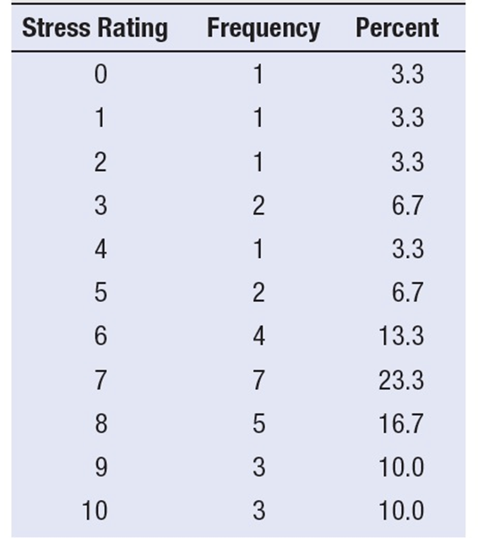
Analysing Data: Frequency Tables (2)
8,7,4,10,8,6,8,9,9,7,3,7,6,5,0,9,10,7,7,3,6,7,5,2,1,6,7,10,8,8
Notes:
Make a list down the page of each possible value, from lowest to highest
Go one by one through the scores, making a mark for each next to its value on the list
Make a table showing how many times each value on the list is used
Figure the percentage of scores for each value

Slide 14
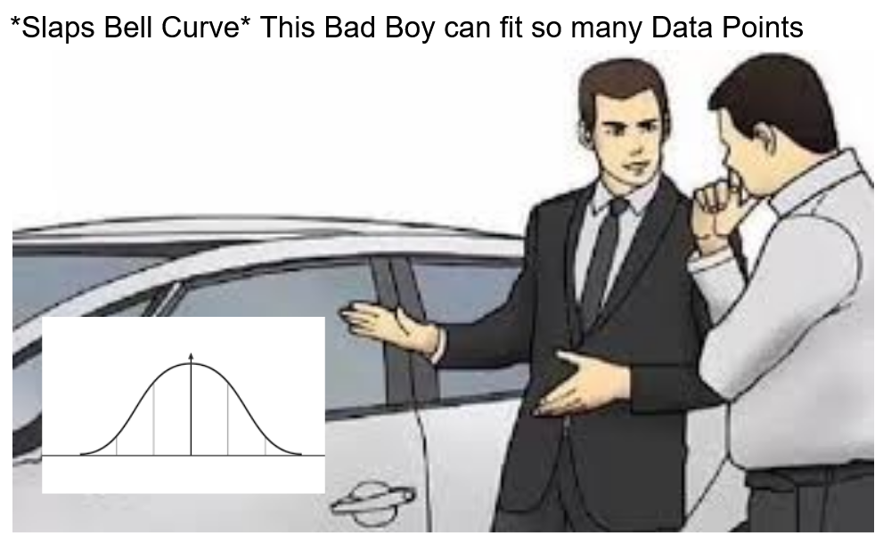
Analysing Data: Histograms
Frequency Distributions (aka Histograms)
  A graph plotting values of observations on the horizontal axis, with a bar showing how many times each value occurred in the data set.
The ‘Normal’ Distribution
  Bell shaped
  Symmetrical around the centre

Slide 15
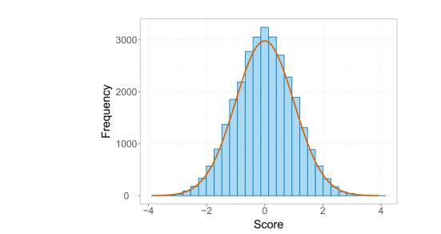
The Normal Distribution
Notes:
The normal distribution is a special type of histogram with a “bell” shaped curve

Slide 16
Properties of Frequency Distributions
Skew
  The symmetry of the distribution.
  Positive skew (scores bunched at low values with the tail pointing to high values).
  Negative skew (scores bunched at high values with the tail pointing to low values).
Kurtosis
  The ‘heaviness’ of the tails.
  Leptokurtic = heavy tails.
  Platykurtic = light tails.

Slide 17
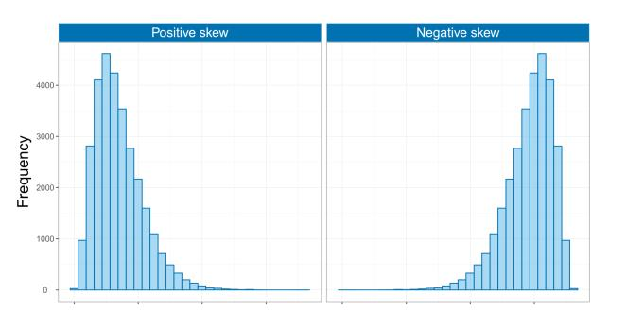
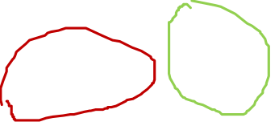
Skew

Slide 18
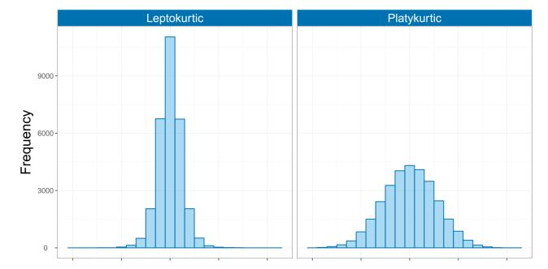
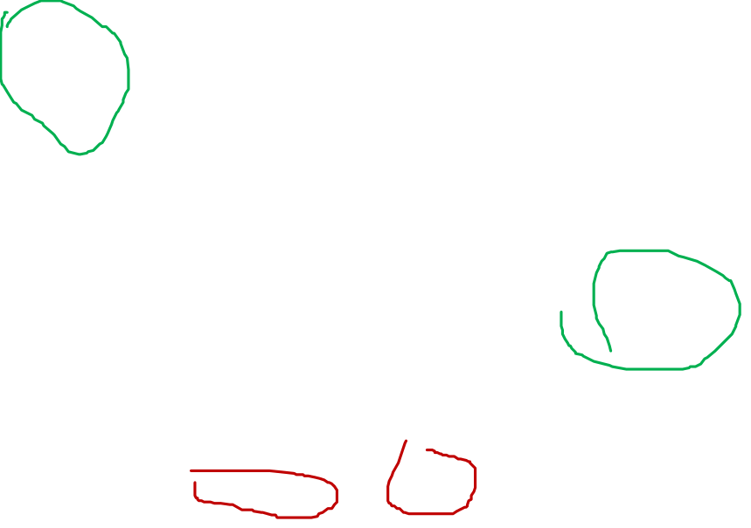
Kurtosis

Slide 19
Central Tendency: The Mode
Mode
  The most frequent score
Bimodal
  Having two modes
Multimodal
  Having several modes

Slide 20
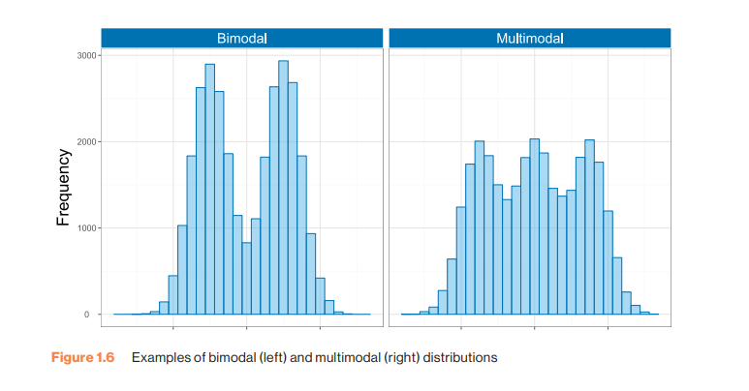
Bimodal and Multimodal Distributions

Slide 21
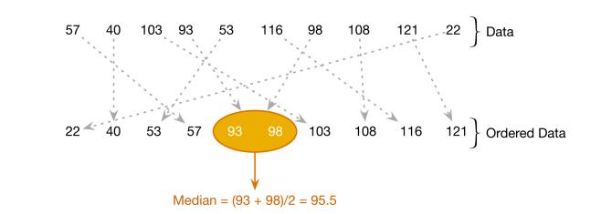
Central Tendency: The Median
Notes:
When the data contain an even number of scores, the median is the average of the middle two values

Slide 22
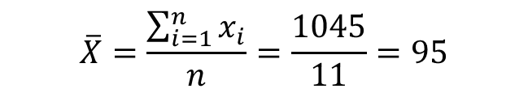
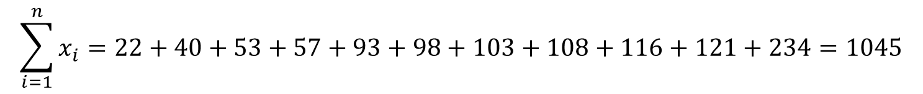
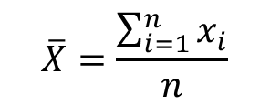

Central Tendency: The Mean
Mean
  The sum of scores divided by the number of scores.
  Number of friends of 11 Facebook users.
$$\overline{X}=\frac{\sum_{i=1}^{n}{x_{i}}}{n}$$
$$\sum_{i=1}^{n}{x_{i}}=\text{22}+\text{4}0+\text{53}+\text{57}+\text{93}+\text{98}+\text{1}0\text{3}+\text{1}0\text{8}+\text{116}+\text{121}+\text{234}=\text{1}0\text{45}$$
$$\overline{X}=\frac{\sum_{i=1}^{n}{x_{i}}}{n}=\frac{1045}{11}=95$$

Slide 23
The Dispersion: Range
The Range
  The smallest score subtracted from the largest
  For our Facebook friends data the highest score is 234 and the lowest is 22; therefore, the range is 234 − 22 = 212.

Slide 24
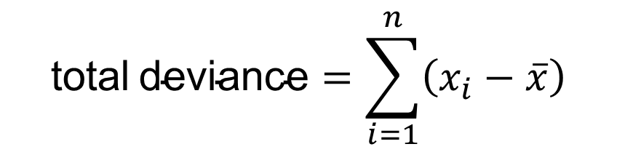

Deviance
We can calculate the spread of scores by looking at how different each score is from the center of a distribution e.g. the mean.
$$\text{deviance}\text{= }x_{i}−\overline{x}$$
$$\text{total} \text{deviance}=\sum_{i=1}^{n}{\left(x_{i}−\overline{x}\right)}$$

Slide 25
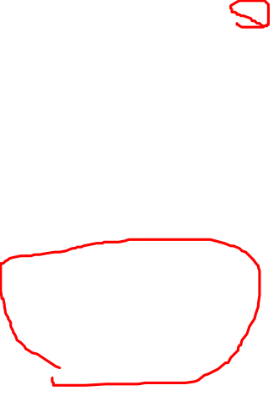
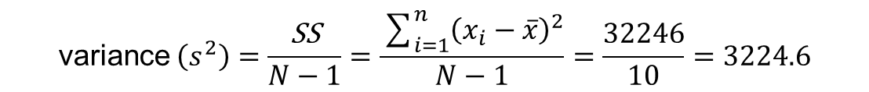
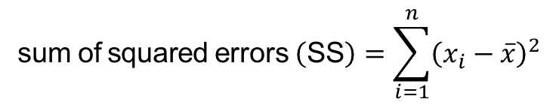
Sum of Squared Errors, SS
Indicates the total dispersion, or total deviance of scores from the mean:
It’s size is dependent on the number of scores in the data.
More useful to work with the average dispersion, known as the variance:
$$\text{sum} \text{of} \text{squared} \text{errors} \left(\text{SS}\right)=\sum_{i=1}^{n}{{\left(x_{i}−\overline{x}\right)}^{2}}$$
$$\text{variance} \left(s^{2}\right)=\frac{\text{SS}}{N−1}=\frac{\sum_{i=1}^{n}{{\left(x_{i}−\overline{x}\right)}^{2}}}{N−1}=\frac{32246}{10}=3224.6$$

Slide 26
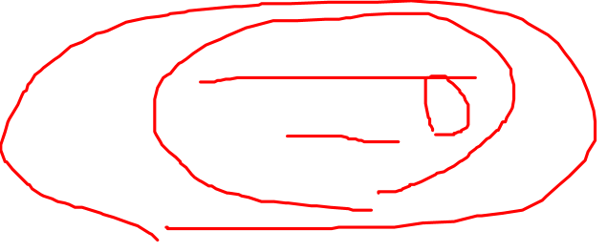
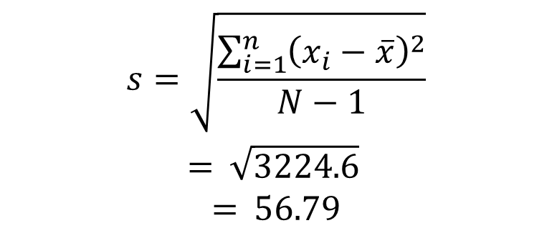
Standard Deviation
The variance gives us a measure in units squared.
  In our Facebook example we would have to say that the average error in our data was 3224.6 friends squared.
This problem is solved by taking the square root of the variance, which is known as the standard deviation:
$$\begin{matrix}s=\sqrt{\frac{\sum_{i=1}^{n}{{\left(x_{i}−\overline{x}\right)}^{2}}}{N−1}} \\ = \sqrt{3224.6} \\ = 56.79\end{matrix}$$

Slide 27
Step 1
Find the distance from the mean to each score (deviation score)
Step 2
Square each deviation score
Step 3
Sum up all squared deviations (Sum of Squares, SS)
Step 4
Divide the SS by the total number of observations (the variance)
Population Variance =
Step 5
Take the square root of the variance
Population Standard Deviation =
Notes:
There are five steps to calculating standard deviation

Slide 28
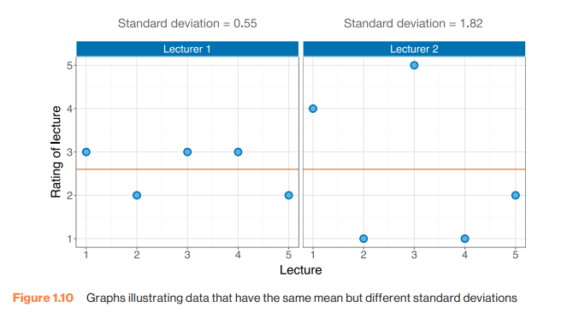
Same Mean, Different sd

Slide 29
Important Things to Remember
The sum of squares, variance and standard deviation represent the same thing:
  The ‘Fit’ of the mean to the data
  The variability in the data
  How well the mean represents the observed data
  Error

Slide 30
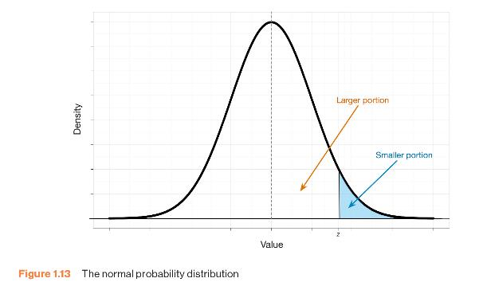
The Normal Probability Distribution

Slide 31
Going Beyond the Data: Z-scores
Z-scores
  Standardizing a score with respect to the other scores in the group.
  Expresses a score in terms of how many standard deviations it is away from the mean.
  The distribution of z-scores has a mean of 0 and SD = 1.

Slide 32

Z-Score Formula
$$z=\frac{X−\overline{X}}{s}$$

Slide 33
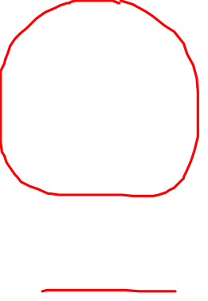
Properties of Z-scores
1.96 cuts off the top 2.5% of the distribution.
−1.96 cuts off the bottom 2.5% of the distribution.
95% of z-scores lie between −1.96 and 1.96.
99% of z-scores lie between −2.58 and 2.58.
99.9% of them lie between −3.29 and 3.29.

Slide 34
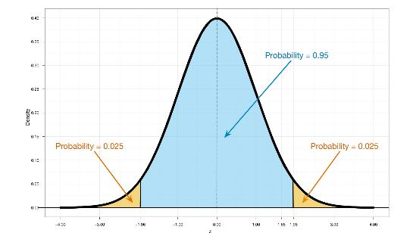
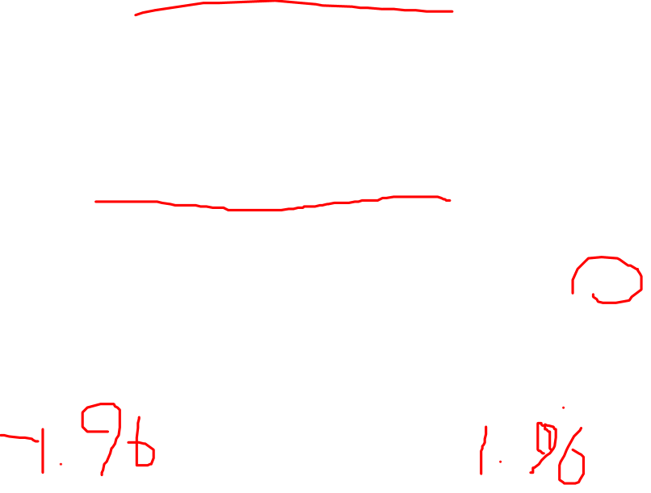
Probability Density Function of a Normal Distribution

Slide 35
Why use z-scores?
Can compare between individuals in different populations
Can compare between measures on different scales

